Slide 1
Self-Publishing Basics Lesson 3 Designing Book Covers
Tamara Marnell
Central Oregon Community College
Continuing Education
This course material by Tamara Marnell is licensed under a Creative Commons Attribution 4.0 International License.

Slide 2
Learning Outcome & Objectives
Design book covers for use in print and eBook publications.
Use publisher-provided templates or specifications in Photoshop to design covers.
Produce (a) JPG files for use in eBooks and (b) flattened PDF files with correct color profiles for printing.

Slide 3
The Importance of Covers
People must judge books by their covers.
When shoppers see a book, they know little or nothing about it.
They make split-second decisions to learn more or not based on the cover.
Covers convey genre, tone, and quality of the content inside.
Good covers capture the interest of the intended audience.

Slide 4
Principles of Design

Slide 5
Genre and Tone
Book genres follow certain conventions that make them recognizable.

Slide 6
Genre and Tone
Designs can push the envelope...

Slide 7
Genre and Tone
…as long as they accurate convey what readers can expect!

Slide 8
Readability
Avoid small and excessively stylized fonts.

Slide 9
Readability
Avoid noisy backgrounds and low-contrast colors.

Slide 10
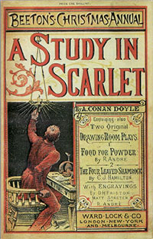
Scalability
Covers need to look good in print, on smartphones, and in thumbnails.

Slide 11
Simplicity
Professional covers have simple designs: large text and one central image.

Slide 12
Activity: Design Your Cover
First, research current trends in cover designs for your genre. You can look at the New York Times Bestseller lists, genres in Goodreads, or this 2018 article of Book Cover Ideas. Save links to books with covers you'd like to emulate: the ones that catch your eye and invite you to click them for more information.
Next, brainstorm ideas for your own design.
What single strong image represents your book?
What mood should the design evoke? (Playful? Epic? Tragic? Cozy?)
What character should the typography have? (Formal or informal? Blocky or loopy? Traditional or modern?)
Finally, sketch out your composition, or describe it in notes.

Slide 13
Images and Fonts

Slide 14
Copyright Concerns
All images, fonts, and other intellectual property (IP) are under copyright with all rights reserved, unless they are…
Public Domain Images
Works created by the U.S. Government
Works with expired copyrights
Works dedicated to the public domain by the copyright holders
Openly Licensed
Under copyright, but the copyright holders have given the public permission to use the works in specific ways.
Examples:
Open-source software under GNU
Fonts under the SIL Open Font License
Art with Creative Commons (CC) licenses

Slide 15
Model Releases
If a person in a photograph is identifiable, they have the right to decide whether and how the image can be used commercially.
Professional photographers ask models to sign release forms in advance.
Reputable stock photo websites require model releases with all image submissions.

Slide 16
How to Find Images
Commercial Stock Photos
Even the biggest companies rely on stock photos for cover designs.
Royalty-free photos are available for purchase from about $50 to $500 or more.
Popular websites include…
Getty Images
iStock
Adobe Stock
Shutterstock
Public Domain and Creative Commons
Use Google Images to search for pictures labeled for reuse.
Always read the license details on the original website.

Slide 17
Reading Licenses
The following images come up in a Google Images search for “Deschutes River” with the “Labeled for reuse” filter applied.
Which can be used on a book cover? Which require attribution?
Dillon Falls, Deschutes River - Deschutes National Forest
A calm fall afternoon beside the Deschutes River in LaPine State Park
Deschutes River Near Redmond
Tumalo Falls Hiking: Deschutes River
Steelhead Falls on the Deschutes River

Slide 18
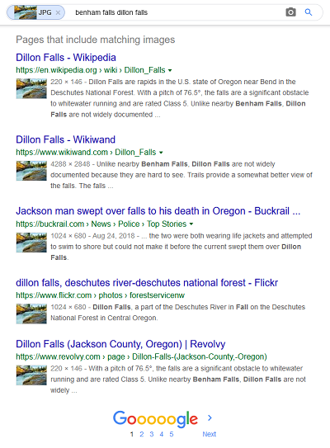
Double-Checking Ownership
Bad actors can copy images from one website to another and claim ownership.
To double-check that an image is truly free to use, use Google’s “Search by image” feature.
There will always be some risk to using art you find on the Internet.

Slide 19
Typographical Covers
Covers can use typography and colors alone to communicate the genre and tone of a book.

Slide 20
How to Find Fonts
Choose readable fonts that aren’t too common.
Times New Roman, Calibri, Comic Sans etc. have cultural “baggage.”
Many websites offer libraries of custom fonts.
Google Fonts
Font Squirrel
Read licenses to check whether a font can be used for commercial projects.

Slide 21
Activity: Gather Your Cover Elements
Using the composition you prepared in the previous activity, search for stock images and fonts you can use to build the design.
Reminders:
Always read licenses.
Before using an image of a person, make sure there's a signed model release form.
Verify the ownership of works as thoroughly as you can. There are dishonest people on the web!

Slide 22
Creating Cover Files

Slide 23
Using Microsoft Word
Technically, it's possible to build your cover using Microsoft Word.
Example tutorial: How to Make Your Own Book Cover Using MS Word
However, Word is called Word, not Art!
Moving objects is difficult, especially when you layer them.
You can't easily see and control the exact sizes, colors, and positions of objects.
Documents can be exported as PDFs only.

Slide 24
Using Adobe Photoshop
Subscription service through Adobe Creative Cloud costs $20-30 per month. Open-source alternatives like GIMP have similar features.
COCC Library has two computers with Photoshop available to all community members.
Photoshop tutorials are readily available on the web.
The Basics of Photoshop
How to Make a Paperback Book Cover in Photoshop

Slide 25
Using Platform Tools
Applications can build covers automatically from templates.
Examples:
Amazon Cover Creator
Blurb BookWright
Canva
Lulu Cover Wizard

Slide 26
Exporting Cover Files
For print, export a PDF in CMYK color mode.
Flatten all layers before exporting.
For eBooks, save a JPG or PNG in RGB color mode.
Crop the image to show the front cover only.
Save the image in the highest quality you can without exceeding 2 MB or so.

Slide 27
Service | Ratio | Recommended Size | Resolution | Documentation
Amazon KDP | 1.6:1 | 2560px tall by 1600px wide | 300 PPI | Create an eBook Cover
Barnes and Noble | Not specified | At least 1400px on each side | Not specified | Nook Press Formatting Guidelines
Bookbaby | 1.5:1 | 2100px tall by 1400px wide | Minimum 72 DPI | Preparing for eBook Conversion
Draft2Digital | 1.5:1 | 2400px tall by 1600px wide | Not specified | How to Publish with Draft2Digital
iBooks | Not specified | 1873px tall by 1400px wide | Not specified | iBooks Publisher User Guide (p. 21)
IngramSpark | 1.6:1 | 2560px tall by 1600px wide | Not specified | File Requirements for eBooks
Kobo | 4:3 | Not specified | 900 DPI | Cover Image Tips
Lulu | Not specified | 792px tall by 612px wide | 150 DPI or less | Image dimensions for uploading an image for eBook cover
Smashwords | 1.5:1 or 1.6:1 | 2400px tall by 1600px wide | Not specified | Smashwords Style Guide

Slide 28
Activity: Make Your Cover
Use Photoshop to build your cover file.
Use the requirements and/or templates from your chosen platform to set up the document.
Design the front cover, spine, and back cover.
Save your PSD file in a safe place, so you don't lose your work when you flatten and crop for exporting.
Flatten your image and export your completed file as a PDF in CMYK color mode.
Crop the image for eBooks and marketing. Export as a high-quality JPG or PNG in RGB color mode.
Nobody builds a perfect cover on the first try. Experiment with different images, fonts, colors, textures, and effects. You might be surprised by the design that emerges in the end!

