Slide 1
Self-Publishing Basics Lesson 4 Publishing Print Books and Ebooks
Tamara Marnell
Central Oregon Community College
Continuing Education
This course material by Tamara Marnell is licensed under a Creative Commons Attribution 4.0 International License.

Slide 2
Learning Outcome & Objectives
Create and distribute print books and eBooks.
Write bibliographic metadata for print books and eBooks.
Use a publishing service to produce and distribute finished print books and eBooks.

Slide 3
About Metadata
In publishing, metadata is information that describes a book.
Examples: title, author, summary, publication date, language(s) used, subject headings, identifiers
Traditional publishers submit applications to the Library of Congress (LOC) to catalog titles. Self-publishers can optionally apply for the Preassigned Control Number (PCN) program.
For self-publishers, metadata is important for…
Discoverability
Differentiation
Fill out as much as you can, but don’t worry about “strategy.”
Accuracy is most important

Slide 4
Activity: Write Your Metadata
In a text document, write down the basic metadata for your book.
Use plain text with no special characters or formatting.
You’ll copy the metadata into electronic forms in many different places.
Save the file in a reliable place.

Slide 5
Field | Example
Title | The Great American Novel
Sort Title | Great American Novel, The
Author Name | Jane Doe
Author Sort Name | Doe, Jane
Series | (Blank)
Volume | (Blank)
Edition | First
Publication Date | October 31, 2019
Identifiers | e-ISBN: 9780312345678 Print ISBN: 9780323456789 ASIN: B12RDY3V45
Print Length | 300 pages
BISAC Subject Headings* | FIC014000 FICTION / Historical / General FIC066000 FICTION / Small Town & Rural
Description | It's 1903, and schoolteacher Grace Jones is looking for adventure. She finds it in the sunny frontier settlement of Farewell Bend. When an ambitious young banker, a handsome doctor, and a brash newspaper man come to town with big ideas, Grace gets more than a fun caper in the Wild West--she witnesses history in the making. In this fictionalized account of the founding of modern-day Bend, the stars of Central Oregon history come to life.
Keywords | Bend, Central Oregon, Deschutes County, pioneers, Pacific Northwest history
Author Bio | Jane Doe grew up in Central Oregon and has a passion for preserving the region's rich history through storytelling. She lives in Sisters with her partner and their two Scottish terriers.

Slide 6
About Ebooks

Slide 7
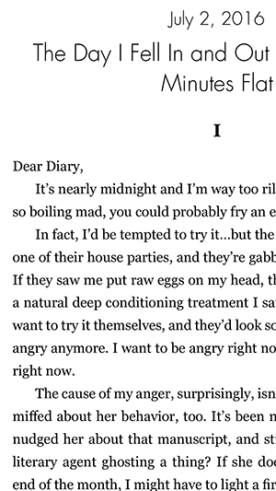
Fixed Format: PDF
PDFs are convenient for distribution.
Great for Open Educational Resources
Send to reviewers, link in giveaways, etc.
Pros
PDFs always look like they did in your design program.
Adobe Reader can display pages side-by-side to simulate the book in print.
Cons
PDFs look good only on large screens.
The files are difficult to use on mobile devices.

Slide 8
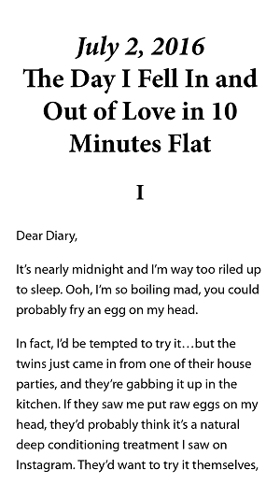
Reflowable Formats: EPUB and MOBI
EPUB and MOBI formats are what people most commonly think of as eBooks.
EPUBs are the open file format accepted by most services.
MOBI is Amazon’s proprietary format for Kindle.
Pros
Easy to read on mobile devices because the content adjusts to the screen.
Built-in features like bookmarks and linked Table of Contents in the menu.
Cons
Users must own eReaders or special apps.
Designs must be simple to display nicely.
Colorful sidebars, columns of text, and floating images will look “squished.”

Slide 9
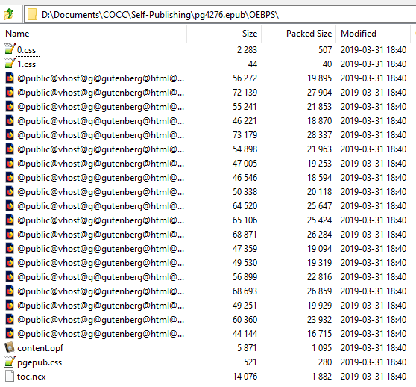
Ebook Structure
EPUBs are ZIP files full of webpages.

Slide 10
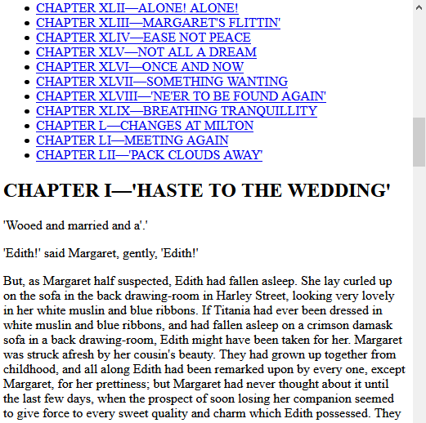
Ebook Structure
You can open any of the HTML files in a browser, just like a website.

Slide 11
Multimedia
Because a modern eBook is made of webpages, you can include multimedia content.
Images
Videos
Audio files
Multimedia content can result in large file sizes.
Check if this will affect your list price and royalties.

Slide 12
Digital Rights Management (DRM)
DRM encrypts books so they can’t be shared between different people or devices.
The files must be opened in a special program like the Kindle app, Adobe Digital Editions, etc.
Publishing services might give you the choice of applying DRM or not.
Arguments for DRM
Discourages piracy
Restricts unreasonable sharing and copy/pasting
Arguments against DRM
Readers can’t transfer books they’ve bought to multiple devices.
If the special programs go away, so do the books.
Pirates are too smart.

Slide 13
Activity: Your Ebook Experiences
Reflect on your past experiences with eBooks.
Which formats do you prefer, and why?
Have you had a frustrating experience with an eBook? What made it difficult or unpleasant to use?
Have you had a great experience with an eBook? What attractive or convenient features would you like to emulate in your own book?

Slide 14
Ebook Conversion

Slide 15
Word Docs to Ebooks
In the early 2010s, Smashwords was the most popular service for generating eBooks. Now in 2019 Internet sources commonly recommend Draft2Digital and Kindle Create.
Draft2Digital
No finicky format requirements
Front and back matter optionally added during setup
Demonstration: How to Convert Your Manuscript to Ebook
Template options shown at 18:34
Kindle Create
Free desktop software from Amazon
Produces MOBI files only
Demonstration: Kindle Create Tutorial

Slide 16
Webpages to Ebooks
Open-source software Calibre converts HTML to EPUB and MOBI files.
Useful if…
You composed your manuscript in a program other than Word
You have experience in web development and want to apply custom styles
Your manuscript contains multimedia
Calibre allows you to edit EPUB files after they’re created.

Slide 17
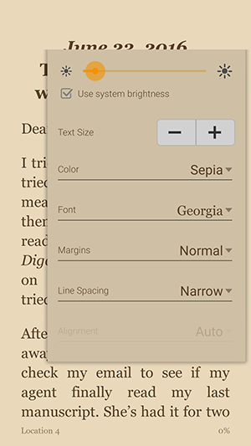
Testing
Test your eBook files on different devices and apps.
Check the appearance of text, images, and page breaks
Review the table of contents
Test any internal links
Apply common customization features
Resize the font
Change the background color
Adjust margins and spacing
EPUB: use a free app like Aldiko or BlueFire Reader
MOBI: use the Kindle Previewer on a desktop or the Kindle app for mobile devices

Slide 18
Activity: Create an Ebook
Using the service or software of your choice, convert the clean manuscript you created in Lesson 2 into various eBook formats.
Produce PDF, EPUB, and/or MOBI files.
Test the files to see how they look on eReaders and apps.
Make changes as necessary, reproduce the files, and test again until you're satisfied the eBooks are ready for distribution.

Slide 19
Ebook and POD Setup
Ebook files can be sold immediately.
Print books require patience. You’ll need to…
Upload your cover and interior files.
Preview the book digitally.
Order a proof copy.
Wait two to three weeks for the proof to arrive.
Adjust your cover and/or interior as necessary. Repeat from step one.
Printed books rarely turn out perfectly on the first try.
Budget for multiple proofs
Set your launch date a couple of months in the future

Slide 20
Activity: Set Up Your Book Editions
In the service of your choice, set up your paperback, hardcover, and/or eBook. Use the metadata you wrote down earlier to fill out the product details, and upload the relevant content and cover files.
Congratulations—you made a book!

